Slide 1

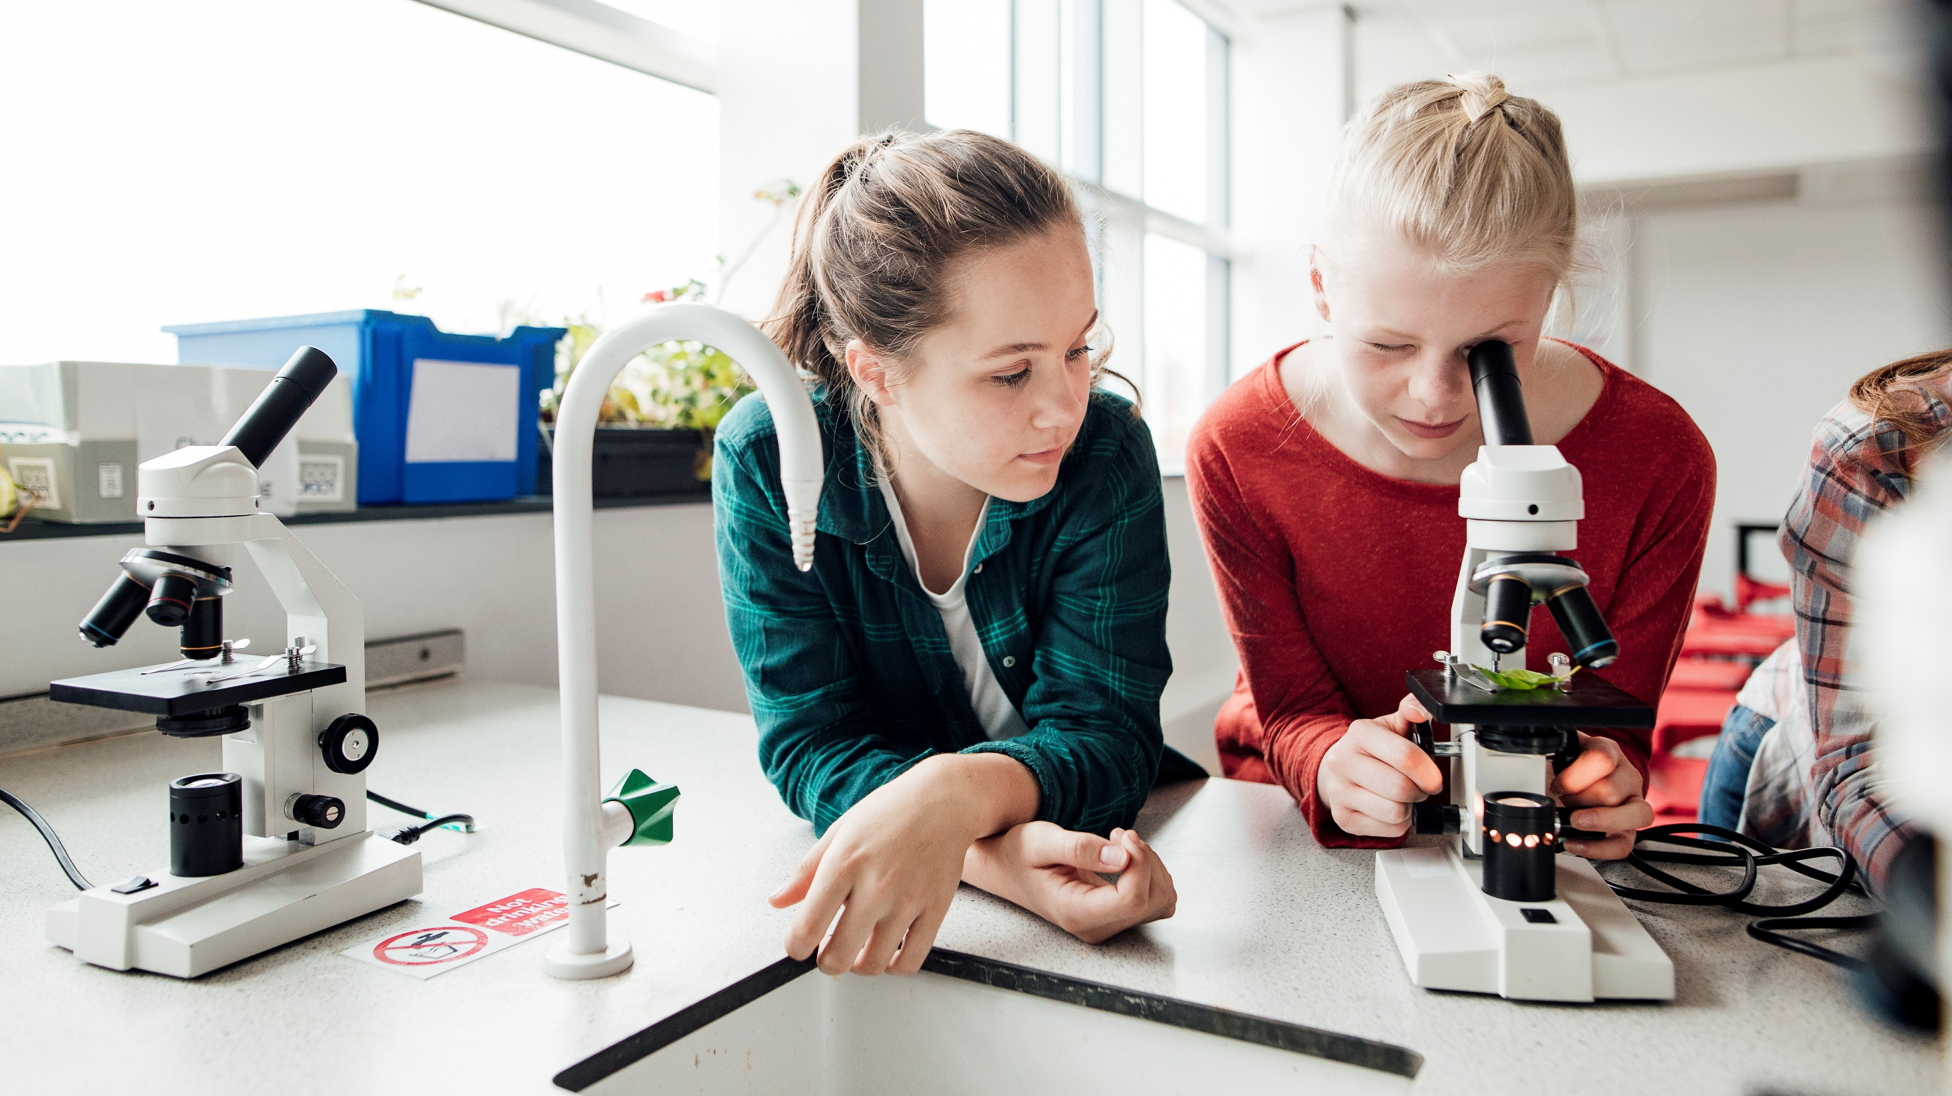
hackathon Healthcare technology

Slide 2
By Christin brothers
Christin benny
Amal tom Ajith
Shravan S kammath

Slide 3
Table of contents
Title Slide
Table Of Contents
Problem Statement Slide
Proposed Solution Slide
Practical implications
Implementation Slide
Model/Flow Diagram Slide
Conclusion Slide

Slide 4
Problem Statement:
Manual Surgical Workflows and Their Limitations:
Manual surgical procedures often involve significant challenges, Including human error, variability in surgeon skill levels, and physical limitations during intricate operations. These issues can lead to longer recovery times, increased risk of complications, and inconsistent patient outcomes
A Study of perioperative outcomes for abdominoperineal resections for colorectal cancer at one institution found that, compared to patients who underwent laparoscopic surgery, patients who underwent robotic surgery had a significantly reduced complication rate (13.2% vs 23.7%, respectively)
Possible risks of surgery include postoperative pain, pneumonia, blood clots, a reaction to anesthesia, surgical site infection, nerve damage, and surgical accidents. Speak with your surgeon beforehand to fully understand the risks and benefits as they pertain to you as an individual.

Slide 5
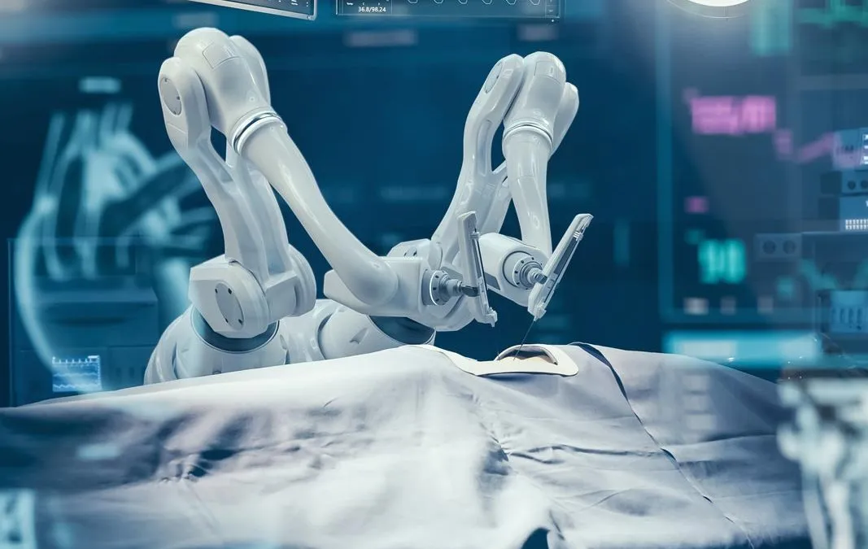
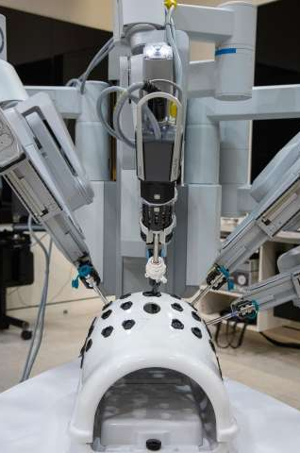
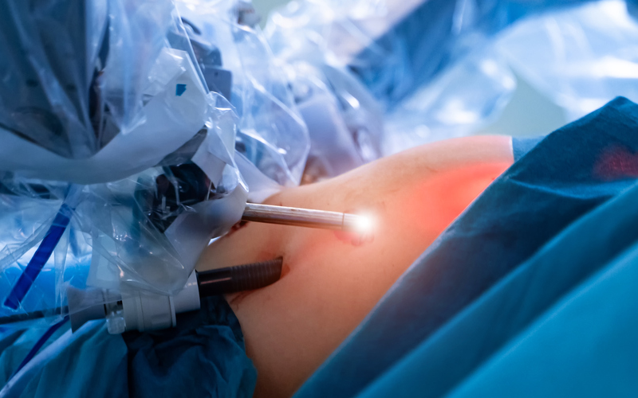
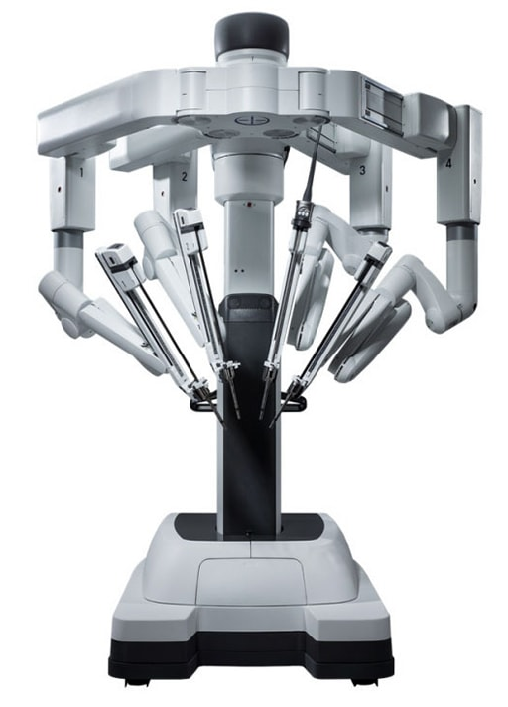
Proposed Solution: robotic surgery automation, as…
Accuracy
Remote Surgery
3D Imaging

Slide 6
In brief..
Leveraging advanced robotic systems like the Da Vinci Surgical System, we aim to automate surgical workflows. This automation includes precise control of surgical instruments, enhanced visualization through 3D imaging, and AI-assisted decision-making to ensure accuracy and consistency in complex surgical procedures.
Surgeons who use the robotic system find that it can increase precision, flexibility and control during the operation. The robotic system also allows them to better see the site, compared with traditional surgical methods. Using robotic surgery, surgeons can perform delicate and complex procedures that may be difficult or impossible with other methods.
Robotic surgery often is done through tiny openings in the skin and other tissues. This approach is called a minimally invasive surgery. The benefits of minimally invasive surgery include:
Fewer complications, such as surgical site infection.
Less pain and blood loss.
A shorter hospital stay and quicker recovery.
Smaller, less noticeable scars.

Slide 7
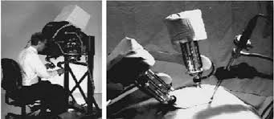
Practical Implications
Patient Outcomes:
Reduced Recovery Time: Patients typically experience faster recovery times due to smaller incisions and less trauma during surgery.
Lower Risk of Complications: Enhanced precision reduces the likelihood of surgical errors, leading to fewer post-operative complications and infections.
Minimized Scarring: Smaller incisions result in less visible scarring, improving cosmetic outcomes for patients.

Slide 8
Cont..
Accessibility and Training:
Teleoperation: Surgeons can operate remotely, allowing patients in underserved or remote areas access to high-quality surgical care from specialists.
Training and Skill Enhancement: Surgeons can use robotic systems to enhance their skills through simulation and practice, leading to overall improvements in surgical expertise and confidence.
Collaborative Surgery: Multiple surgeons can collaborate on complex procedures, combining their expertise to achieve the best possible outcomes for patients.
Surgical Efficiency:
Consistent Performance: Robots can perform repetitive tasks with consistent accuracy, reducing variability in surgical outcomes due to human fatigue or error.
Shorter Hospital Stays: Faster recovery times and fewer complications mean patients can be discharged sooner, reducing hospital costs and freeing up resources for other patients.

Slide 9
Implementations
Research and Development:
Literature Review: Study existing robotic surgery systems like the Da Vinci Surgical System to understand their design, functionalities, and limitations.
Technology Assessment: Identify the necessary hardware (robotic arms, surgical instruments, imaging systems) and software (AI algorithms, control systems) components.
Design and Prototyping:
System Design: Develop a comprehensive design plan detailing the mechanical, electrical, and software architecture of the robotic system.
Prototyping: Create a prototype of the robotic surgical system, focusing on the key functionalities such as precision control, 3D visualization, and AI assistance.

Slide 10
Cont..
Software Development:
Control Algorithms: Develop algorithms for precise control of the robotic arms and surgical instruments.
AI Integration: Implement AI for real-time decision-making, error detection, and enhanced visualization.
User Interface: Design an intuitive user interface for surgeons to control the robotic system and monitor the surgery.
Testing and Validation:
Simulation Testing: Conduct extensive simulations to test the system’s performance and accuracy in various surgical scenarios.
Clinical Trials: Collaborate with medical professionals to perform clinical trials, ensuring the system meets safety and efficacy standards.

Slide 11
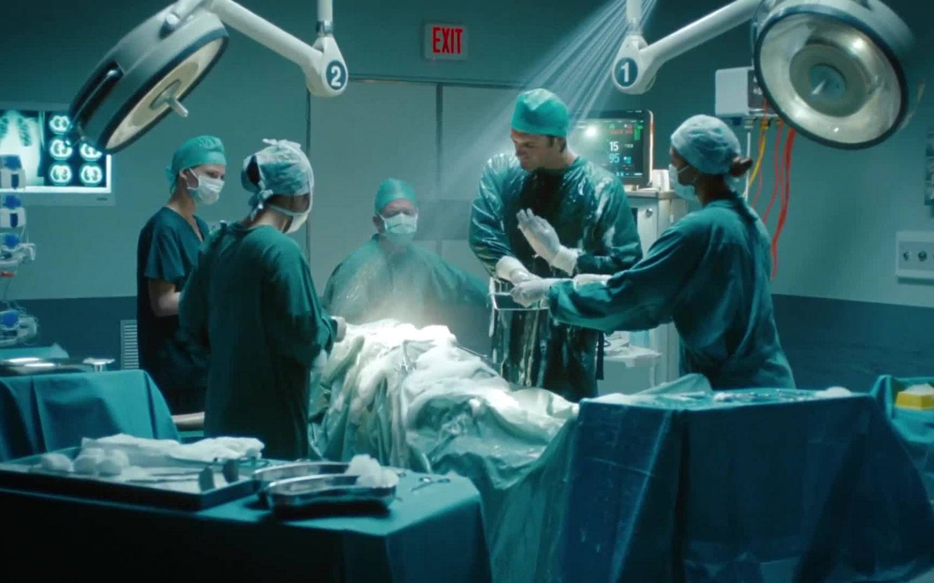
Cont…
Training and Documentation:
Surgeon Training: Develop a training program for surgeons to become proficient in using the robotic system.
User Manuals: Create comprehensive documentation and user manuals for operating and maintaining the system.

Slide 12
3D/Spacial imaging
Example code for image interpretation
//Libraries
import cv2
import tensorflow as tf
import numpy as np
//Assume that we have a saved model
model = tf.keras.models.load_model('path/to/your/model.h5')
//Image preproccessing
def preprocess_image(image_path):
# Load image
image = cv2.imread(image_path)
# Convert to RGB (if your model expects RGB images)
image = cv2.cvtColor(image, cv2.COLOR_BGR2RGB)

Slide 13
Cont….
# Normalize image
image = image / 255.0
# Expand dimensions to match model input shape
image = np.expand_dims(image, axis=0)
return image
//Make predictions on preprocessed image
def predict(image_path):
image = preprocess_image(image_path)
# Perform prediction
predictions = model.predict(image)
# Interpret predictions
# For classification, you might use np.argmax to get the class with highest probability
predicted_class = np.argmax(predictions, axis=1)

Slide 14
Cont…
//The main Function
def main(image_path):
predicted_class = predict(image_path)
print(f'Predicted class: {predicted_class}')
if __name__ == '__main__':
# Replace 'path/to/image.jpg' with the path to your image
main('path/to/image.jpg')

Slide 15
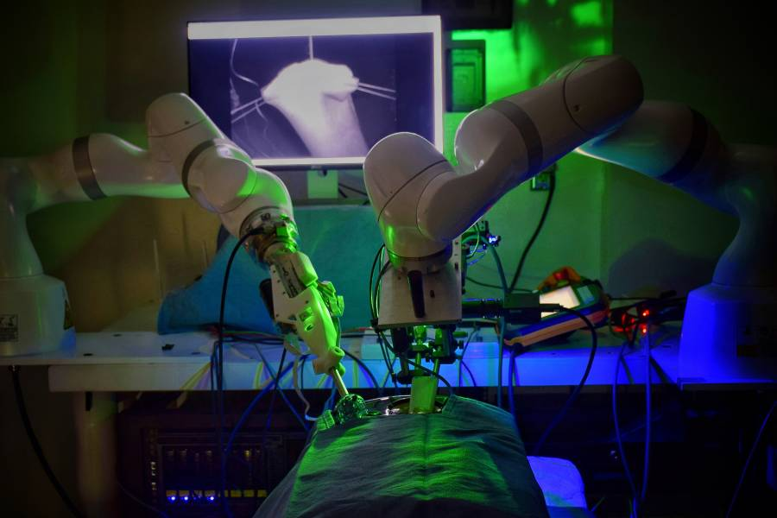
Flow diagram
Research and Development
Design and Prototyping
Software Development
Testing and Validation
Training and documentation
Implimentation in Healthcare
Continues Improvement

Slide 16
Thank You
Christin brothers

